Slide 1

PATHSIM Contact Tracing with Realistic Path Simulation Using Cellphone Log Data Michael Mark Masters Thesis 2021 Computer Science and Information Systems
Notes:
Good afternoon everyone! My name is Michael. I am a Graduate Student at Saginaw Valley State University, with a bachelors in Industrial & Operations Engineering from the University of Michigan. Today I’m going to be talking be about my thesis Pathsim, which is a carrier-based privacy preserving cellphone contact tracing method.

Slide 2

HELLO!
I am Michael Mark
This is my Master’s Thesis Fall 2020 to Winter 2021
You can find me at mmark@svsu.edu
Notes:
Good afternoon everyone! My name is Michael. I am a Graduate Student at Saginaw Valley State University, with a bachelors in Industrial & Operations Engineering from the University of Michigan. Today I’m going to be talking be about my thesis Pathsim, which is a carrier-based privacy preserving cellphone contact tracing method.

Slide 3
HIGH LEVEL OVERVIEW
Current contact tracing methods are ineffective to cope with COVID-19 stress
Pathsim is a novel contact tracing method that:
Uses cellphone log data to compare users’ paths
Preserves users’ privacy
Based on proximity detection rather than localization
No user involvement required and is easy to deploy

Slide 4
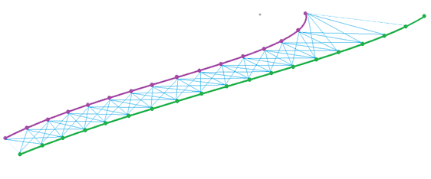
PATHSIM
Contact Tracing
Cellphone LTE Network
VECSIM Prior Work
PATHSIM
Distance Estimation
Path Generation
Tests
Evaluation
PATHSIM Conclusions

Slide 5
1.
CONTACT TRACING
What is contact tracing?

Slide 6
CONTACT TRACING
Method of identifying persons who may have become infected with a disease.
Especially important during COVID-19
Many lives can be saved just by being able to trace people via their cell phones
Notes:
We are essentially tracing the contact between persons so that we can identify those who may be exposed to a disease and then we can prevent onward transmission of the disease.

Slide 7
According to our simulation model, COVID-19 is a pandemic that can only be stopped if at least 10% of the population is tested every day, and testing is conducted under a global, highly targeted contact-tracing strategy…”
- Manuel Cebrian, Nature Electronics 2021
Notes:
Unfortunately, we can see that we are quite far from these goals, since we not only do not have a global contact-tracing strategy nor are people being tested daily to keep the methods up to date. I will go over a few of these methods in the next few slides that several various governments.

Slide 8
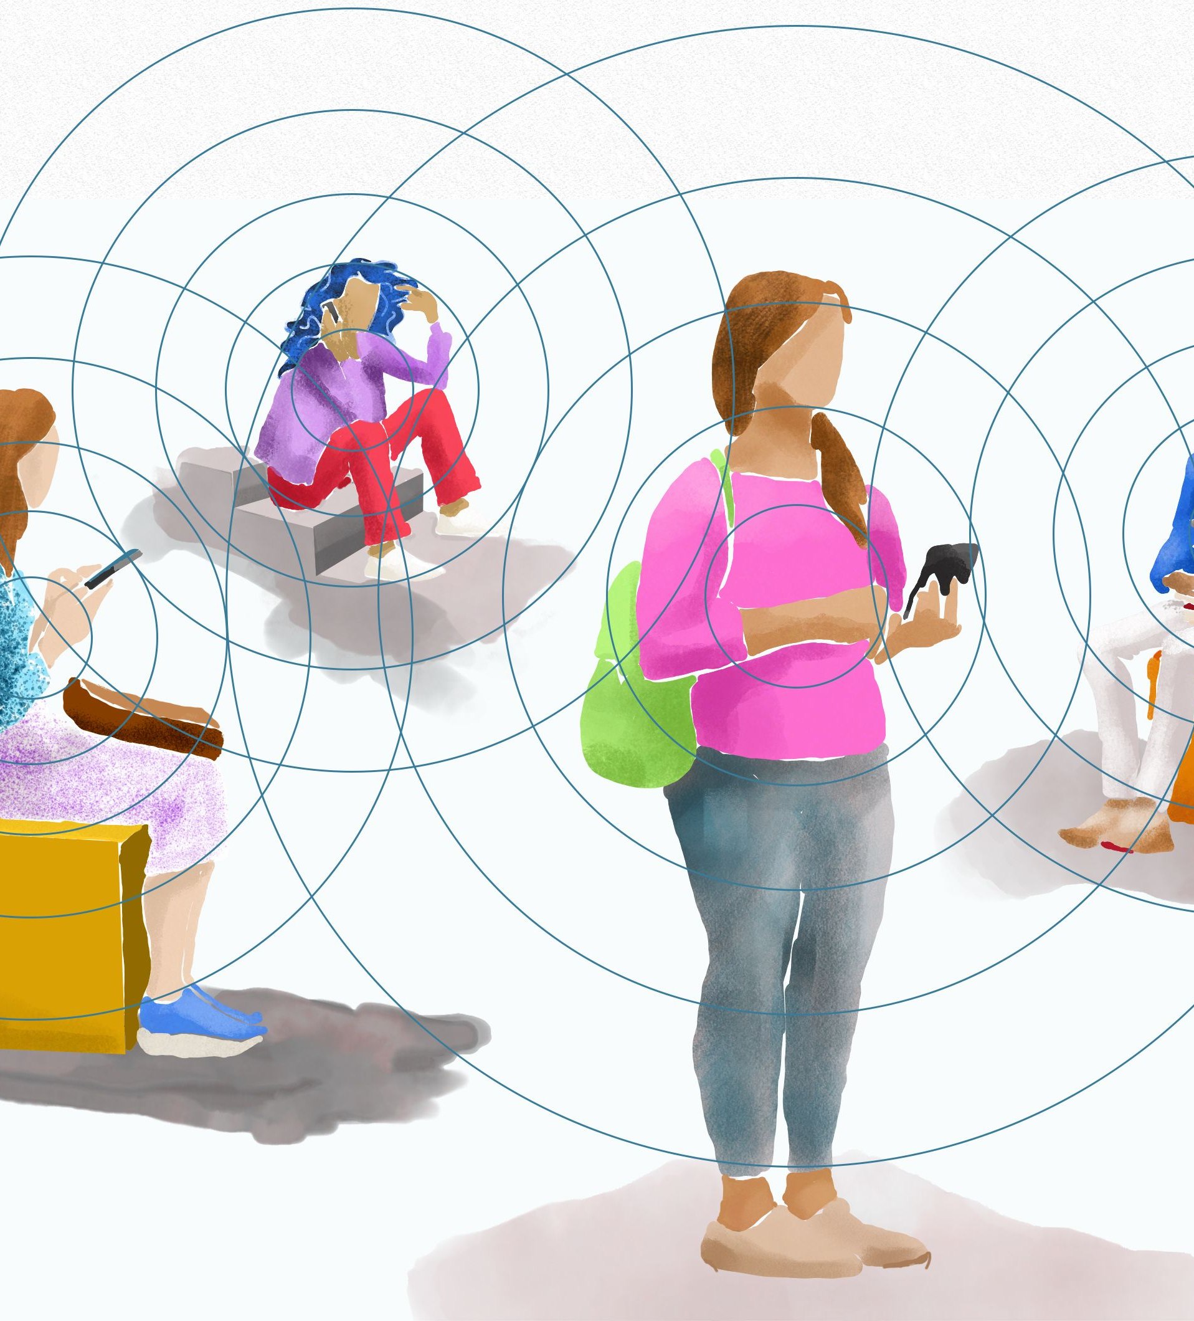
Contact Tracing based on Bluetooth
Uses Bluetooth functionality to track and discover proximity between cellphones (user equipment, or UEs)
Requires user to:
Download app
Give it permissions
Activate Bluetooth
When two phones are in close contact, the Bluetooth modules can discover each other.
Susceptible to well-known network attacks
Many countries have adopted this method
Notes:
30-40 feet
Currently, to try to protect privacy, there are anonymous Bluetooth identifier keys that are generated for each users’ cellphones
So that it prevents other users from knowing your information. However, this information is quite vulnerable to hackers and can be easily stolen since Bluetooth is actually recommended.

Slide 9

SINGAPORE
TraceTogether Bluetooth app on cellphone
Since March 2020
Pings user if other users are in proximity
High adoption rate (over 70% for token and app)
Highly effective, but extremely privacy intrusive
Image Source: https://encrypted-tbn0.gstatic.com/images?q=tbn:ANd9GcSvo0m0QaJLmom946ZbJEra8-6x1TLAr_4B2g&usqp=CAU
Notes:
Adoption rate has gone from 17% from the start to over 70%.
Token is a small item you keep on you if you do not want to download or carry a cellphone.

Slide 10
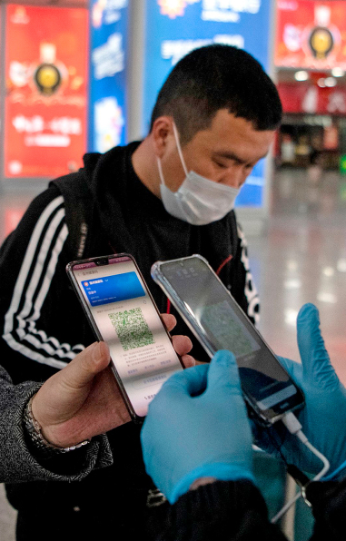
CHINA
Has a virus exceptionalism policy
Uses cellphone apps
QR code scans to check individuals
Before and entering stores
Check temperatures
Image Source: https://content.fortune.com/wp-content/uploads/2020/04/INN.05.20.China-QR-Health-Code.jpg

Slide 11
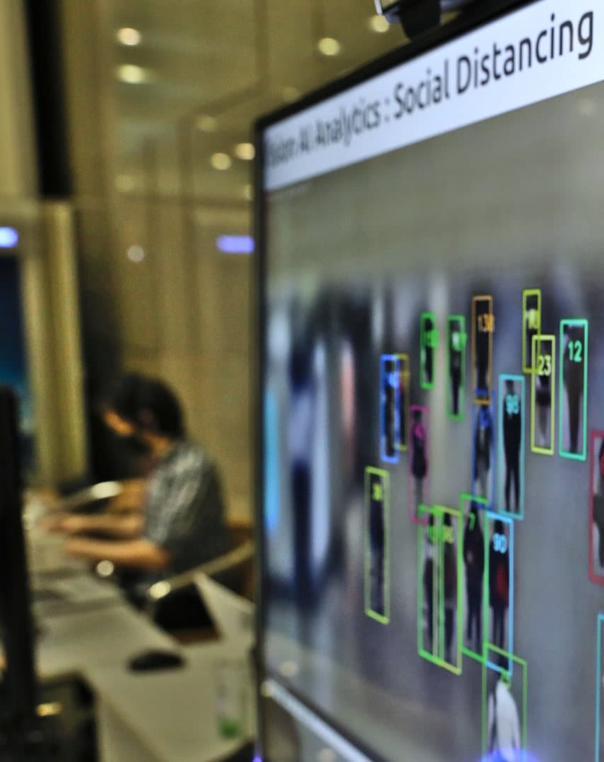
SOUTH KOREA
Uses a combination of:
CCTV footage
Cellphone signal data
Credit card transactions
GPS location data
Image Source: https://undark.org/wp-content/uploads/2020/10/GettyImages-1227136850-edit.jpg

Slide 12
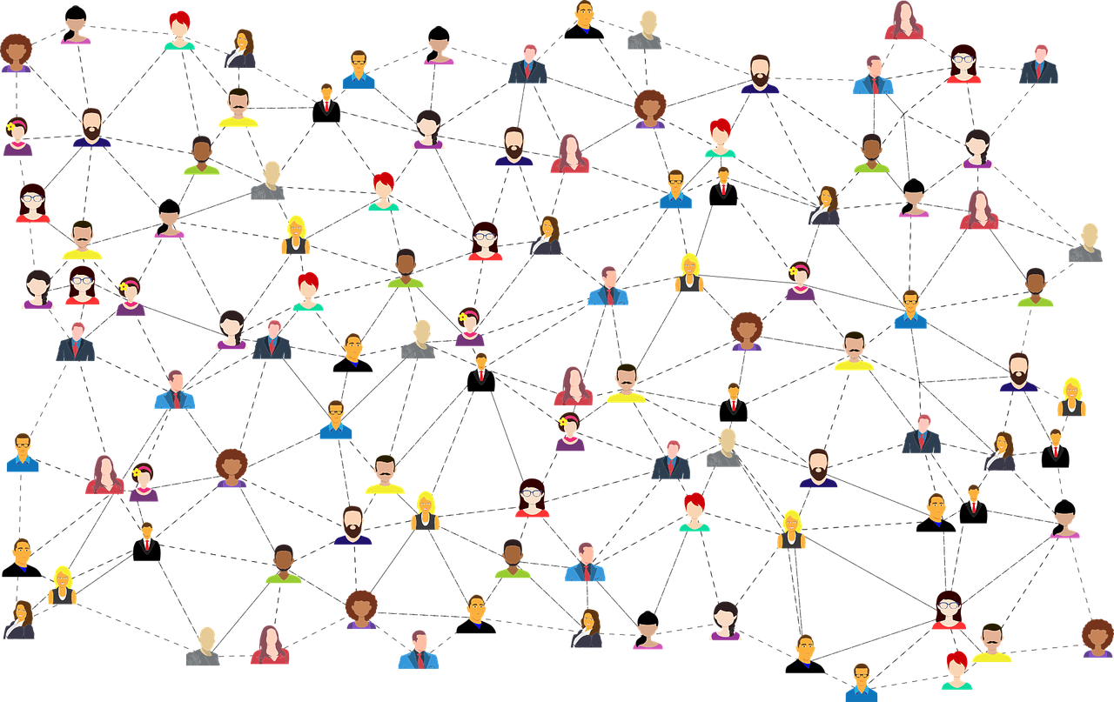
Social media contact tracing
Based off Facebook and other similar social media sites or apps
Uses tagged posts to find users locations based on time stamps (geotag)
Highly intrusive
May lead to identity fraud
Notes:
**Requires users to be active and check into these networks as well

Slide 13
Other Methods of Contact Tracing
Manual Contact Tracing
Used in healthcare
Contact tracing using Wi-Fi
Uses MAC address to do contact tracing
Usually indoors or college campuses
Contact tracing via wearable devices
Used in factories
Notes:
Conduct interviews – relies individuals’ memories to recollect their past movements
Wi-Fi – uses the device pings from Wi-Fi signals at the WiFi access points to determine their locations and whether
Pathsim is not a competitor, can be used in conjunction to these methods.

Slide 14
CURRENT METHODS ARE
Ineffective
Not accurate (Bluetooth between rooms)
Poor adoption rate
Susceptible to network attacks.
User Dependent
Requires the users to take some kind of action:
Download app
Scan codes
Check phones often
Input data
Activate Bluetooth
Privacy Intrusive
Singapore sends all TraceTogether app data to the police that can be used for other purposes* (murder investigations and other crimes)
*Source: https://www.technologyreview.com/2021/01/11/1016004/singapore-tracetogether-contact-tracing-police/
Notes:
Several governments have some form of contact tracing, but only a fraction of the population want to follow directions and adopt.
Privacy Preservation
Protects Users
Protects users’ information and keeps them safe
New age of hackers
More and more phishing attacks and hacking methods are coming out as well as fraudulent exercises, such as flooding attacks like Denial of Service
Builds trust, maintains ethics, and allows development of new contact tracing methods

Slide 15
Does not require user intervention and is privacy preserving
PATHSIM

Slide 16
PATHSIM
Contact Tracing
Cellphone LTE Network
VECSIM Prior Work
PATHSIM
Distance Estimation
Path Generation
Tests
Evaluation
PATHSIM Conclusions
Notes:
LTE networks are widely adopted across many countries today, and this already established system is a great starting point to develop a global, highly targeted contact tracing strategy. Before beginning however, we must cover the background on the fundamentals and terminology of cellphone LTE networks.

Slide 17


2. Cellphone LTE Network
Service areas are covered by a cellphone tower
Each tower typically mounts 3 base stations which are associated with an unique identifier called Physical Cell ID (PCI).
Each base station continuously logs data to an MRO (Mobility Robustness Optimization) file which contains records of all connected cellphones.
User Equipments (UEs), like cellphones, report an MRO record every 5.12 seconds.
Notes:
*MRO file is used by the carrier to automatically analyze and switch the cellphone to a closer tower or base station

Slide 18
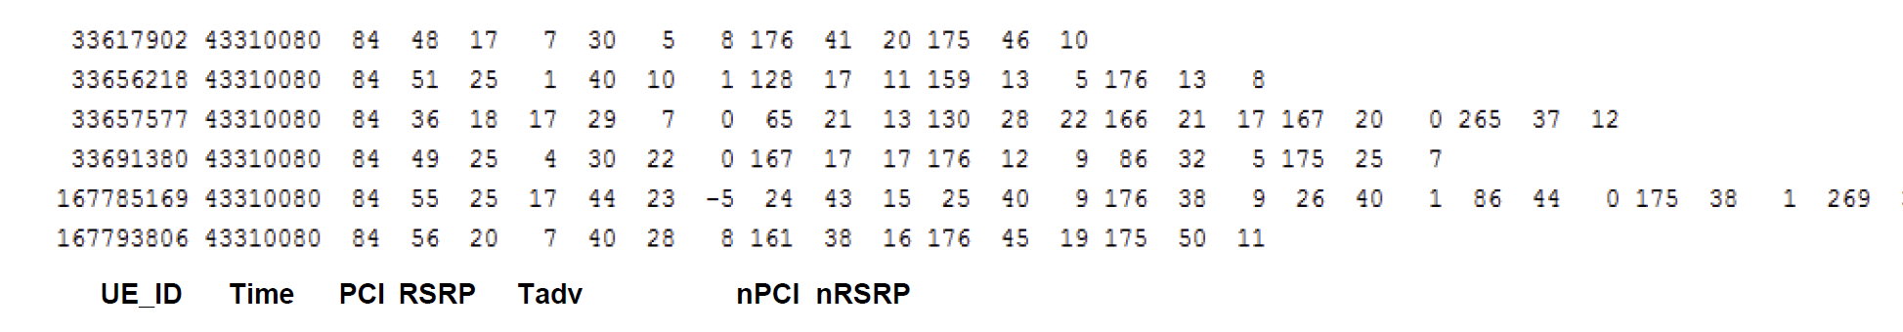
MRO Data
Timing Advance (Tadv): This represents the upper limit of the length of the signal from the base station to the cellphone user, or user equipment (UE).
Angle of Arrival (AoA): Angle from which a signal is received, cellphone observed at the base station. [0, 2π].
Reference Signal Received Power (RSRP): It is a measure of the signal strength between the UE and the connected base station. The cellphone also reports the RSRP values for neighboring base stations in the vicinity (aka nRSRP).
Notes:
RSRP – contains nRSRP which is the strength from neighboring base stations. We do not use these here.
Example of a MRO log data file
Each row contains an MRO vector that has been collected from a particular cellphone –
UE_ID, unique identifier for the cellphone
Time, or timestamp from when the record was collected
PCI, the ID of the base station

Slide 19


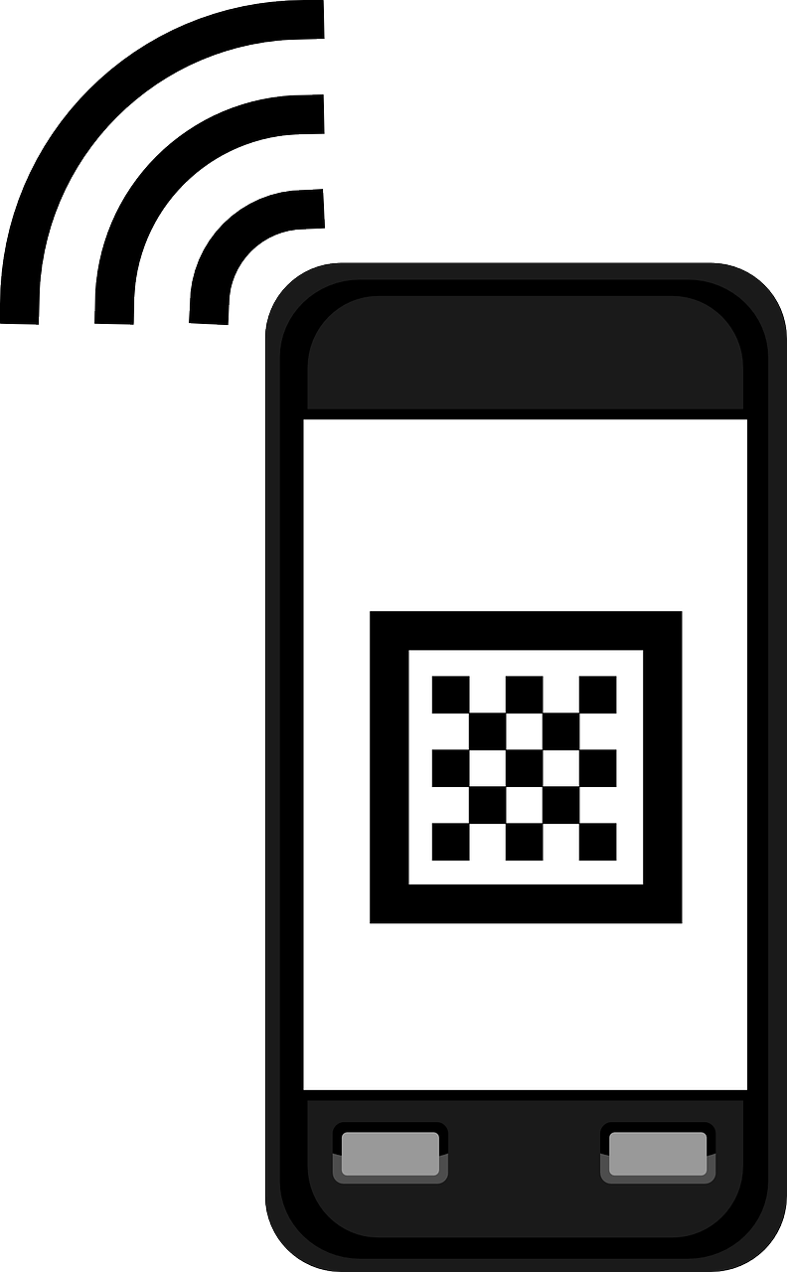
Timing Advance (Tadv)
Tadv represents the upper length of the signal propagation from the device to the tower.
For Non-LOS (line of sight) paths, it is full distance of the path even when reflected off buildings
Line-of-Sight
Non Line-of-Sight
d1
d
d2
Tadv
Tadv = d1 + d2
Notes:
LOS = Tadv will follow tower and cellphone
Non-LOS = Signal may reflect off a building
In Big Cities, LOS is not a realistic expectation since there are many buildings and signals will reflect off the buildings. Therefore, we need to consider the Non-LOS signals as well.
Tadv is not always the accurate representation of the distance estimation.

Slide 20
Angle of Arrival (θ)
Angle from which a signal is received, cellphone observed at the base station. [0, 2π]
This angle is from the top of the tower to the user, based off a reference line that the tower sets.
AoA(θ)
Notes:
Top of tower to user

Slide 21
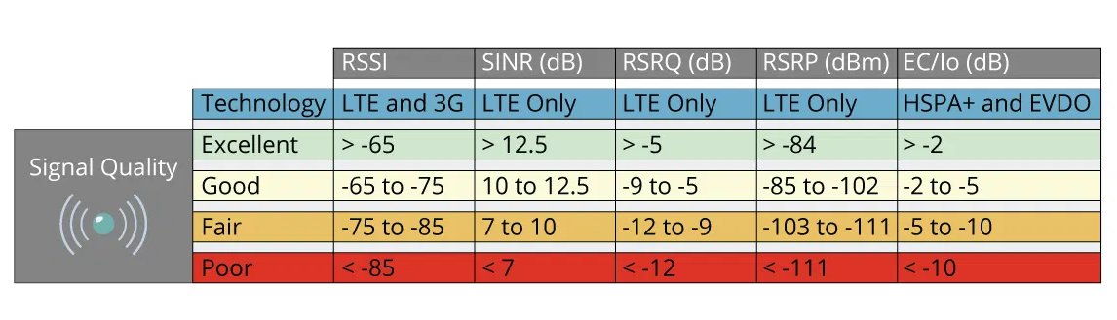
Reference Signal Received Power (𝜔)
RSRP- Signal strength of the base station the cellphone is connected to. Measured in dB/dBm.
MRO file also reports the RSRP values for neighboring base stations in the vicinity (nRSRP).
Notes:
In our data, dB is used and is between 20-70.
nRSRP – neighboring base station RSRP values which will be used in our methodology as well

Slide 22
PATHSIM
Contact Tracing
Cellphone LTE Network
VECSIM Prior Work
PATHSIM
Distance Estimation
Path Generation
Tests
Evaluation
PATHSIM Conclusions
Notes:
I want to talk a bit about the prior work that was done in this field by Professor Mukherjee, called Vecsim. Pathsim actually builds upon this work and it is worth it to take some time to talk about it and understand exactly how it works.

Slide 23
3. VECSIM (Prior Work)
Is the foundation for Pathsim
Preliminary work done by Professor Avishek Mukherjee and others
Novel Contact Tracing Method
Using the MRO data, Vecsim can estimate the distance between 2 users using two points
The data does not contain the user location, therefore preserving user privacy
Notes:
*Vecsim compares only two points and estimates the distance

Slide 24
VECSIM METHOLOGY
Calculate Initial Distance
Determine Maximum Likelihood
Determine if Pairs are Discontinuous (DPD)
Notes:
Vecsim uses 2 Maximum Likelihood functions to further refine the estimate calculated from Step 1.
If the estimate and maximum likelihood functions do not produce an expected result, then Vecsim will determine whether or not the signals from the points are discontinuous.

Slide 25
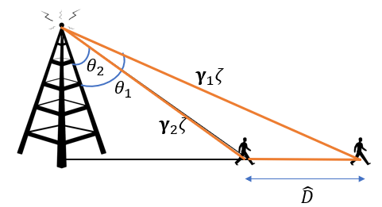
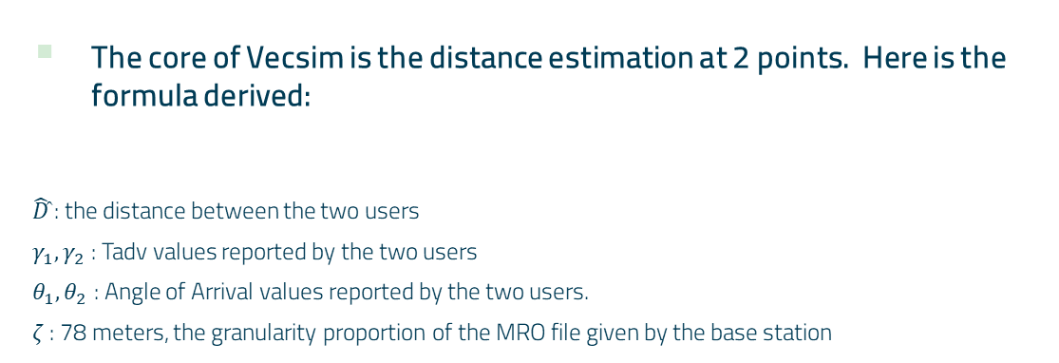
VECSIM Distance Estimation
The core of Vecsim is the distance estimation at 2 points. Here is the formula derived:
$\hat{D}$̂ : the distance between the two users
$γ_{1}, γ_{2}$ : Tadv values reported by the two users
$θ_{1}, θ_{2}$ : Angle of Arrival values reported by the two users.
$ζ$ : 78 meters, the granularity proportion of the MRO file given by the base station
$$\hat{D}={\left[γ_{1}^{2}+ γ_{2}^{2}−2γ_{1}γ_{2}\cos\left(θ_{1}−θ_{2}\right)\right]}^{\frac{1}{2}} ζ$$
Notes:
This is the core of the Vecsim initial distance estimation.
Using simple trigonometry, we can then calculate the distance, D equal to (STATE FORMULA)

Slide 26
VECSIM Methology
Vescim uses the previous formula to calculate the initial Distance Estimation between 2 users, assuming Line of Sight
Then it adds additional adjustments by computing 2 probability density functions based the initial estimate and the RSRP values (signal strength).
Vecsim then uses the Maximum Likelihood Principle to compute a score between 1-8 where 1 represents 25m, and 8 is 200m.
Vecsim also creates a Discontinuity Pairs Database, which stores unusual signals, explained later

Slide 27
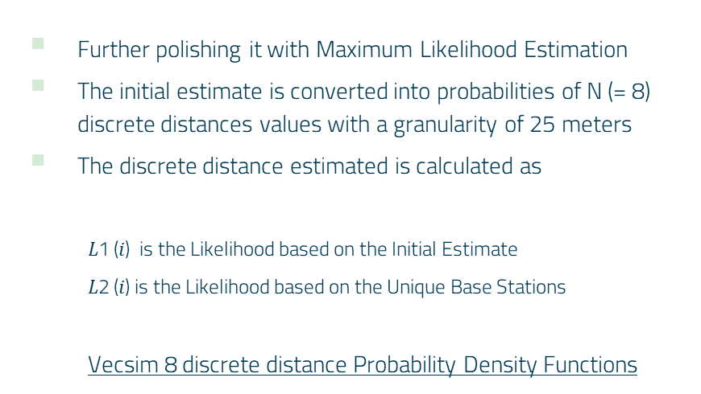
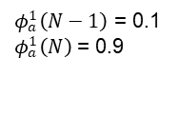
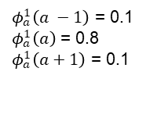
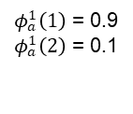
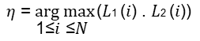
VECSIM Maximum Likelihood Principle
Further polishing it with Maximum Likelihood Estimation
The initial estimate is converted into probabilities of N (= 8) discrete distances values with a granularity of 25 meters
The discrete distance estimated is calculated as
$\text{L}\text{1 (}\text{i}\text{) }$ is the Likelihood based on the Initial Estimate
$\text{L}\text{2 (}\text{i}\text{)}$ is the Likelihood based on the Unique Base Stations
Vecsim 8 discrete distance Probability Density Functions
$$\text{η}\text{ =} \underset{\text{1≤}\text{i}\text{ ≤}\text{N} }{arg max}{\text{(}\text{L}\text{1 }\text{(}\text{i}\text{) . }\text{L}\text{2 }\text{(}\text{i}\text{)) }}$$
$φ_{a}^{1}\left(1\right)$ = 0.9
$φ_{a}^{1}\left(2\right)$ = 0.1
$φ_{a}^{1}\left(a −1\right)$ = 0.1
$φ_{a}^{1}\left(a\right)$ = 0.8
$φ_{a}^{1}\left(a+1\right)$ = 0.1
$φ_{a}^{1}\left(N−1\right)$ = 0.1
$φ_{a}^{1}\left(N\right)$ = 0.9
Notes:
I’d like to talk about how Vecsim creates and uses 2 maximum likelihood principle functions
To do this we first convert our initial estimate into a grid value with a granularity of 25 meters. We use 8 such distances starting from 25, 50 .. Upto 200, Distance estimates beyond 200m are treated as 200m for the purposes of contact tracing. Our final discrete distance estimate is calculated as the largest product of 2 likelihood functions for each of the 8 discrete distances. The 2 likelihood functions we use are the maximum likelihood based on the initial discrete estimate and the ML based on the RSRP of unique base stations.
Our first likelihood is based on the discrete estimate. We basically define a set of 8 PDFs . The idea is that given the actual discrete distance a, we find the probability of our discrete initial estimate.
For example, if the actual discrete distance is 5, and our initial estimate is also 5, we use a probability of 0.8 , to indicate that our estimate is likely to be correct. On the other hand if we get an initial estimate of 6, when the actual distance was 5, then we can say use a probability value of 0.1 meaning it is less likely, but possible.
This is done for all 8 PDFs.
L2 is very similar and has 8 PDFs as well, and is based on the number of unique neighboring base stations for either location. The idea is if the locations are close together, they should hear from same set of base stations they can hear from, while if they are farther apart, they will likely have a different set of base stations in their report.

Slide 28

Signal Discontinuities
In an ideal case, the signal field should be continuous, and our distance estimation should hold for all pairs of locations
However, this assumption does not hold in cities where large buildings can block and reflect signals.
For example, the signal may undergo a large change when emerging from an alley onto a major road.
Vecsim tackles this problem by learning the discontinuity of the signal field using the massive LTE log data available.
Image Source: http://absfreepic.com/free-photos/download/alleyway-in-black-white-photo-6016x4000_54807.html
Notes:
Vecsim uses a Discontinuity Pairs Database, or for short, DPD
Our proposed measurements work well in an ideal scenario when the signal field is continuous, but this assumption does not hold in cities where large buildings and can block and reflect signals. For example, the signal may undergo a large change when emerginf form a small alley onto a major road. We tackle this problem by learning the discontinuity of the signal field using the existing LTE log data.

Slide 29
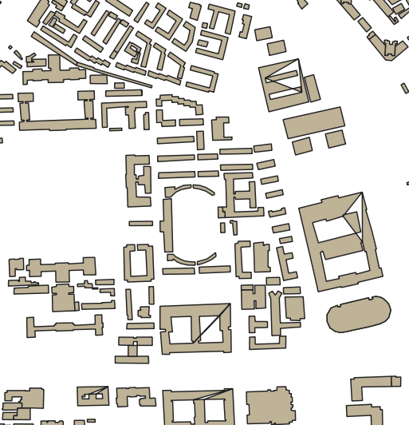

Discontinuity Pairs
If 2 locations A and B are within 25m of each other and their discrete distance estimate 𝜉 (𝑅𝐴, 𝑅𝐵) > 4, then A and B are called a discontinuity pair.
Vecsim checks every such point and their neighbors in the focus area to identify all such discontinuous pairs.
The fraction of discontinuous pairs are significant!
These pairs are all added to the Discontinuity Pair Database (DPD).
In order to find these pairs, Vecsim generated many random walks, but then later used a compression technique to find similar pairs and reduced the database
A
---
B
Notes:
For example, if we zoom in on the map the points A and B shown here are a classic example of a discontinuous pair, where the individual emerged from between 2 building onto a roadway.
if 2 locations A and B are within 25m of each other and their discreate distance estimate is larger than 4, we define A and B as a discontinuity pair

Slide 30
VECSIM LIMITATIONS
Vescim cannot estimate distances between pairs of locations that are connected to different base stations (example to follow)
Random walk simulations used in Vecsim to learn the discontinuous pairs is not realistic
The Discontinuity Pairs Database, even while compressed, may be hard to manage and grow even larger over time
Notes:
The signal data is vastly difference and Vecsim deems the pairs as invalid and cannot compute the distances then.
This was the biggest limitation of Vecsim that prevented it from applicable in a real world scenario.

Slide 31

Vecsim Example: Invalid Pairs
Yellow point (a) and red point (b) are reporting their MRO data to different base station PCIs.
Notes:
We have two points, a and b, who are actually very close together, say within 25-50 meters within each other, so their similarity score should be fairly low.
However, we notice that the base stations that they are reporting to are different.

Slide 32
Vecsim Example: Invalid Pairs
Points near the middle of the paths cannot be compared with VECSIM.
Notes:
Since the two points are being logged by 2 different towers, the MRO data will be vastly different in this situation for these 2 points, even though they are supposed to be close together.
Therefore, Vecsim will say that these points cannot be used to estimate the similarity scores and deem them to be invalid points.

Slide 33
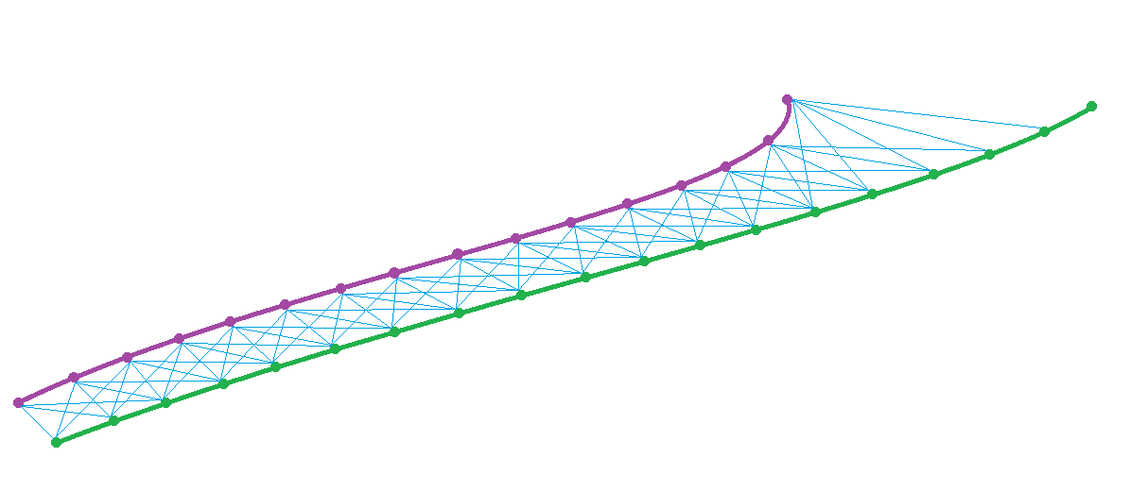
PATHSIM
CONTACT TRACING WITH REALISTIC PATH SIMULATION USING CELLPHONE LOG DATA

Slide 34
PATHSIM METHOLOGY
Simulate Path Generation for Realistic Path Taking
Compare Pairs with Multiple Point Analysis
Determine if Users have been in Contact

Slide 35
PATHSIM
Contact Tracing Method based on the same theoretical foundation as Vecsim
Determines user proximity based on user paths rather than using discrete locations
Aims to overcome the drawbacks of the Vecsim
Improves the performance over Vecsim
Pathsim can compare the paths due to timestamps and being able to trace the paths that the users take from the MRO log data
Notes:
Timestamps – We should note that even though we consider the path information, the locations of the user is still not collected. A path in pathsim is defined as a collection of MRO vectors that belong to the same UE ID and that is reported within a few short timestamps.

Slide 36
Vecsim Example: Invalid Pairs
Points near the middle of the paths cannot be compared with VECSIM.
However, if we consider the neighboring path points from the MRO data
Notes:
Since the two points are being logged by 2 different towers, the MRO data will be vastly different in this situation for these 2 points, even though they are supposed to be close together.
Therefore, Vecsim will say that these points cannot be used to estimate the similarity scores and deem them to be invalid points.

Slide 37
Pathsim Example
Then the points being compared will look like this
Point a being on the green path and point b on the yellow path

Slide 38
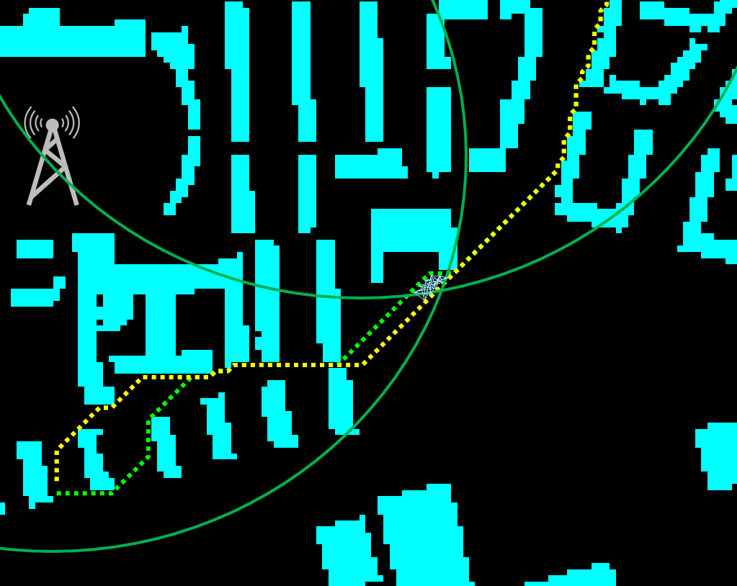
Pathsim Example
PATHSIM will account for this by comparing all of the pairs in a 5x5 matrix and realize the paths are close together along these points
Notes:
It is important to note that we are still utilizing the MRO vector data and NOT the coordinates of the users on these paths to compare the distance estimates of each of the point pairs.
Since the cellphone tower only reports this data and not the users’ actual locations, Pathsim is able to maintain user privacy and not explicitly gather the user’s exact location.

Slide 39
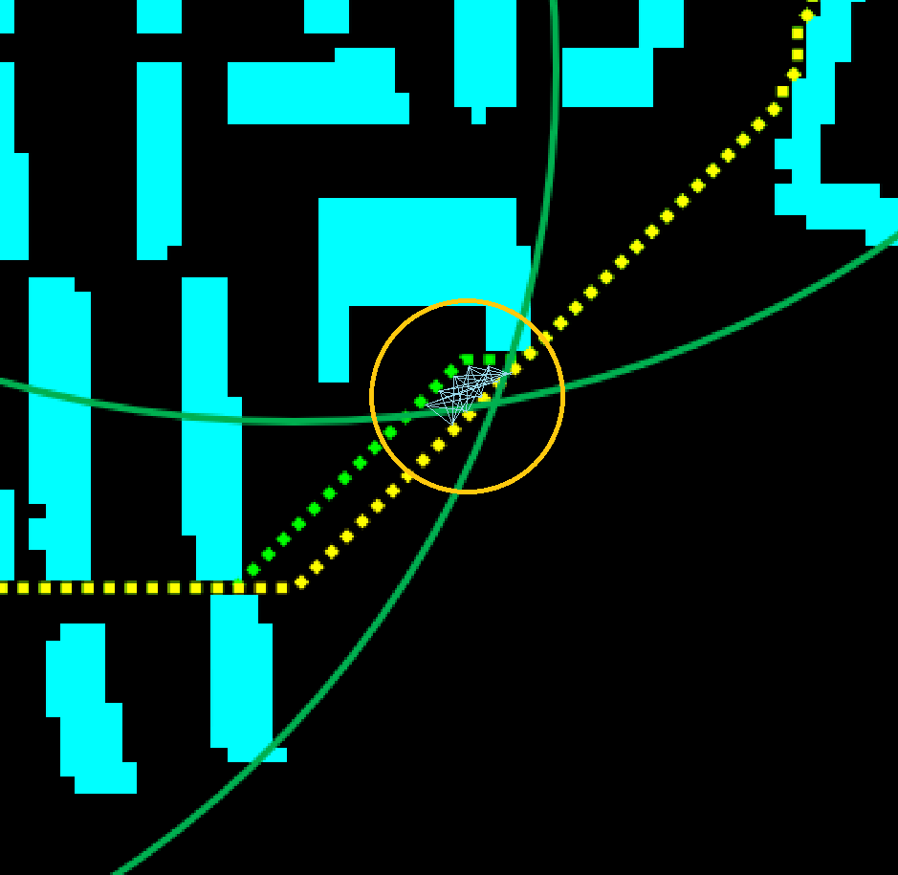
Pathsim Example
Closeup view of the PATHSIM 5x5 web matrix
Notes:
Timestamps and the specific user ID in the MRO data is able to create a path
Traveling under 10-15 m every 5.12 seconds

Slide 40
PATHSIM
Contact Tracing
Cellphone LTE Network
VECSIM Prior Work
PATHSIM
Distance Estimation
Path Generation
Tests
Evaluation
PATHSIM Conclusions

Slide 41
PATHSIM Distance Estimation
Comparing multiple points, point a and point b
Neighboring number of points of K=2
Pathsim compares a matrix of 5 points and calculates the distance estimation for each of them
Notes:
Thus Pathsim introduces a new distance estimation method to improve the accuracy over Vecsim. The idea is still fundamentally the same. We want to approximate the distance between locations a and b. However instead of computing the distance estimate between A and B as explained earlier, we now run our distance estimation algorithm on the neighbors of the original locations as well. This ensures that, for some reason if our distance estimation does not work for a specific location pair a and b, the distance can still be approximated by estimating the distance from the provided data at neighboring locations.

Slide 42
PATHSIM Distance Estimation Key Points
Must be at least 5 points to compare (when K=2)
Final distance estimation is used by calculating the mode of the matrix (i.e. how many of each value)
Multimodal distributions (where there are multiple modes in the matrix), then we had a few different strategies to select a similarity score value
Simple mode – random selection
Averaged mode – average of the total
Notes:
To be more specific we consider the single vector pairs that were reported at 2 consecutive timestamps before and after the signal vector pair that we are estimating, to generate the 5x5 adjacency matrix
Once the matrix has been computed, we can then represent the similarity score as the mode of the valid values found in this matrix. IN case of a tie we use 2 approaches simple mode, which picks a random mode, in the event of a tie. And Averged mode, which averages the most frequently occurring values in the adjacency matrix.

Slide 43
PATHSIM Distance Estimation Examples
Invalid Pairs
When the center point is not comparable, from different towers, Vecsim cannot compute the distance between these pairs
Pathsim checks all 25 points and takes the most frequent value (mode), which is 1 in this example
Notes:
Fairly accurate distance estimate between A and B.
1 represents a maximum distance of 25m, and we find out in this example that the distance estimate value is 1.

Slide 44
PATHSIM Distance Estimation Examples
We have a tie between two values, 11 1’s, 11 2’s
We tested two types of algorithms to handle this:
Simple Mode: random selection
Averaged Mode: takes the average of them and rounds to nearest integer
Multimodal

Slide 45
PATHSIM
Contact Tracing
Cellphone LTE Network
VECSIM Prior Work
PATHSIM
Distance Estimation
Path Generation
Tests
Evaluation
PATHSIM Conclusions

Slide 46
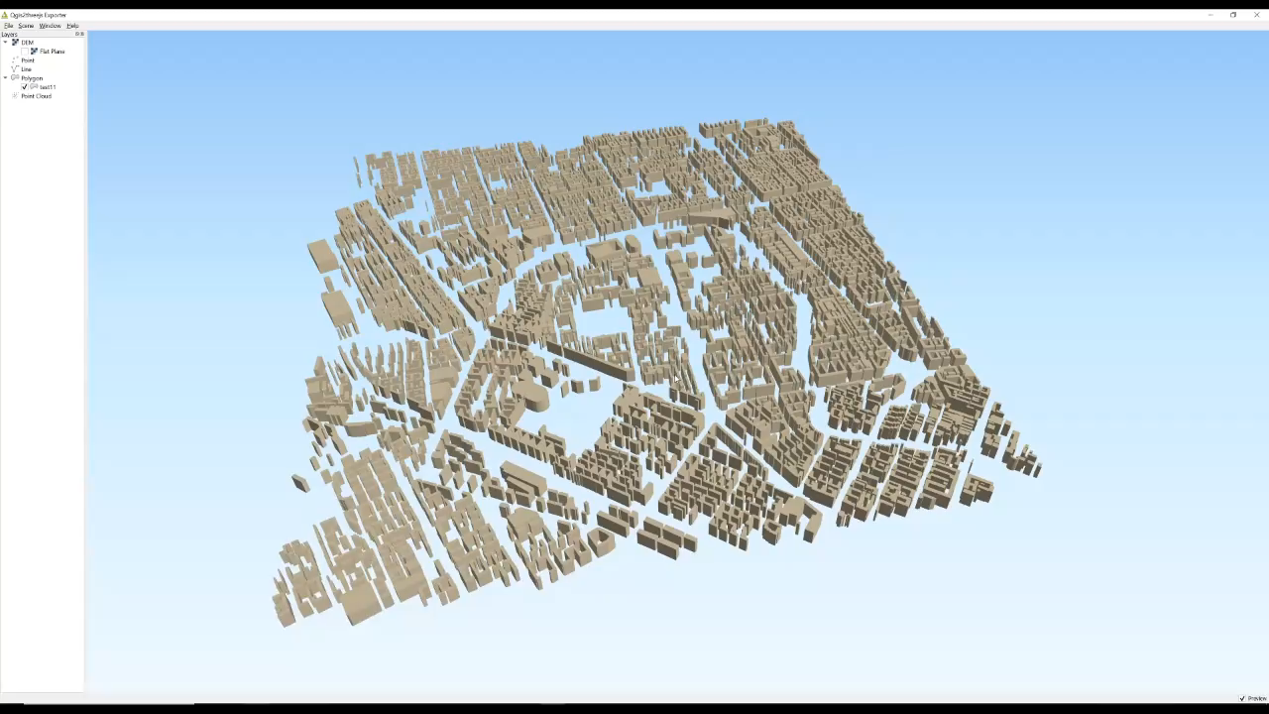
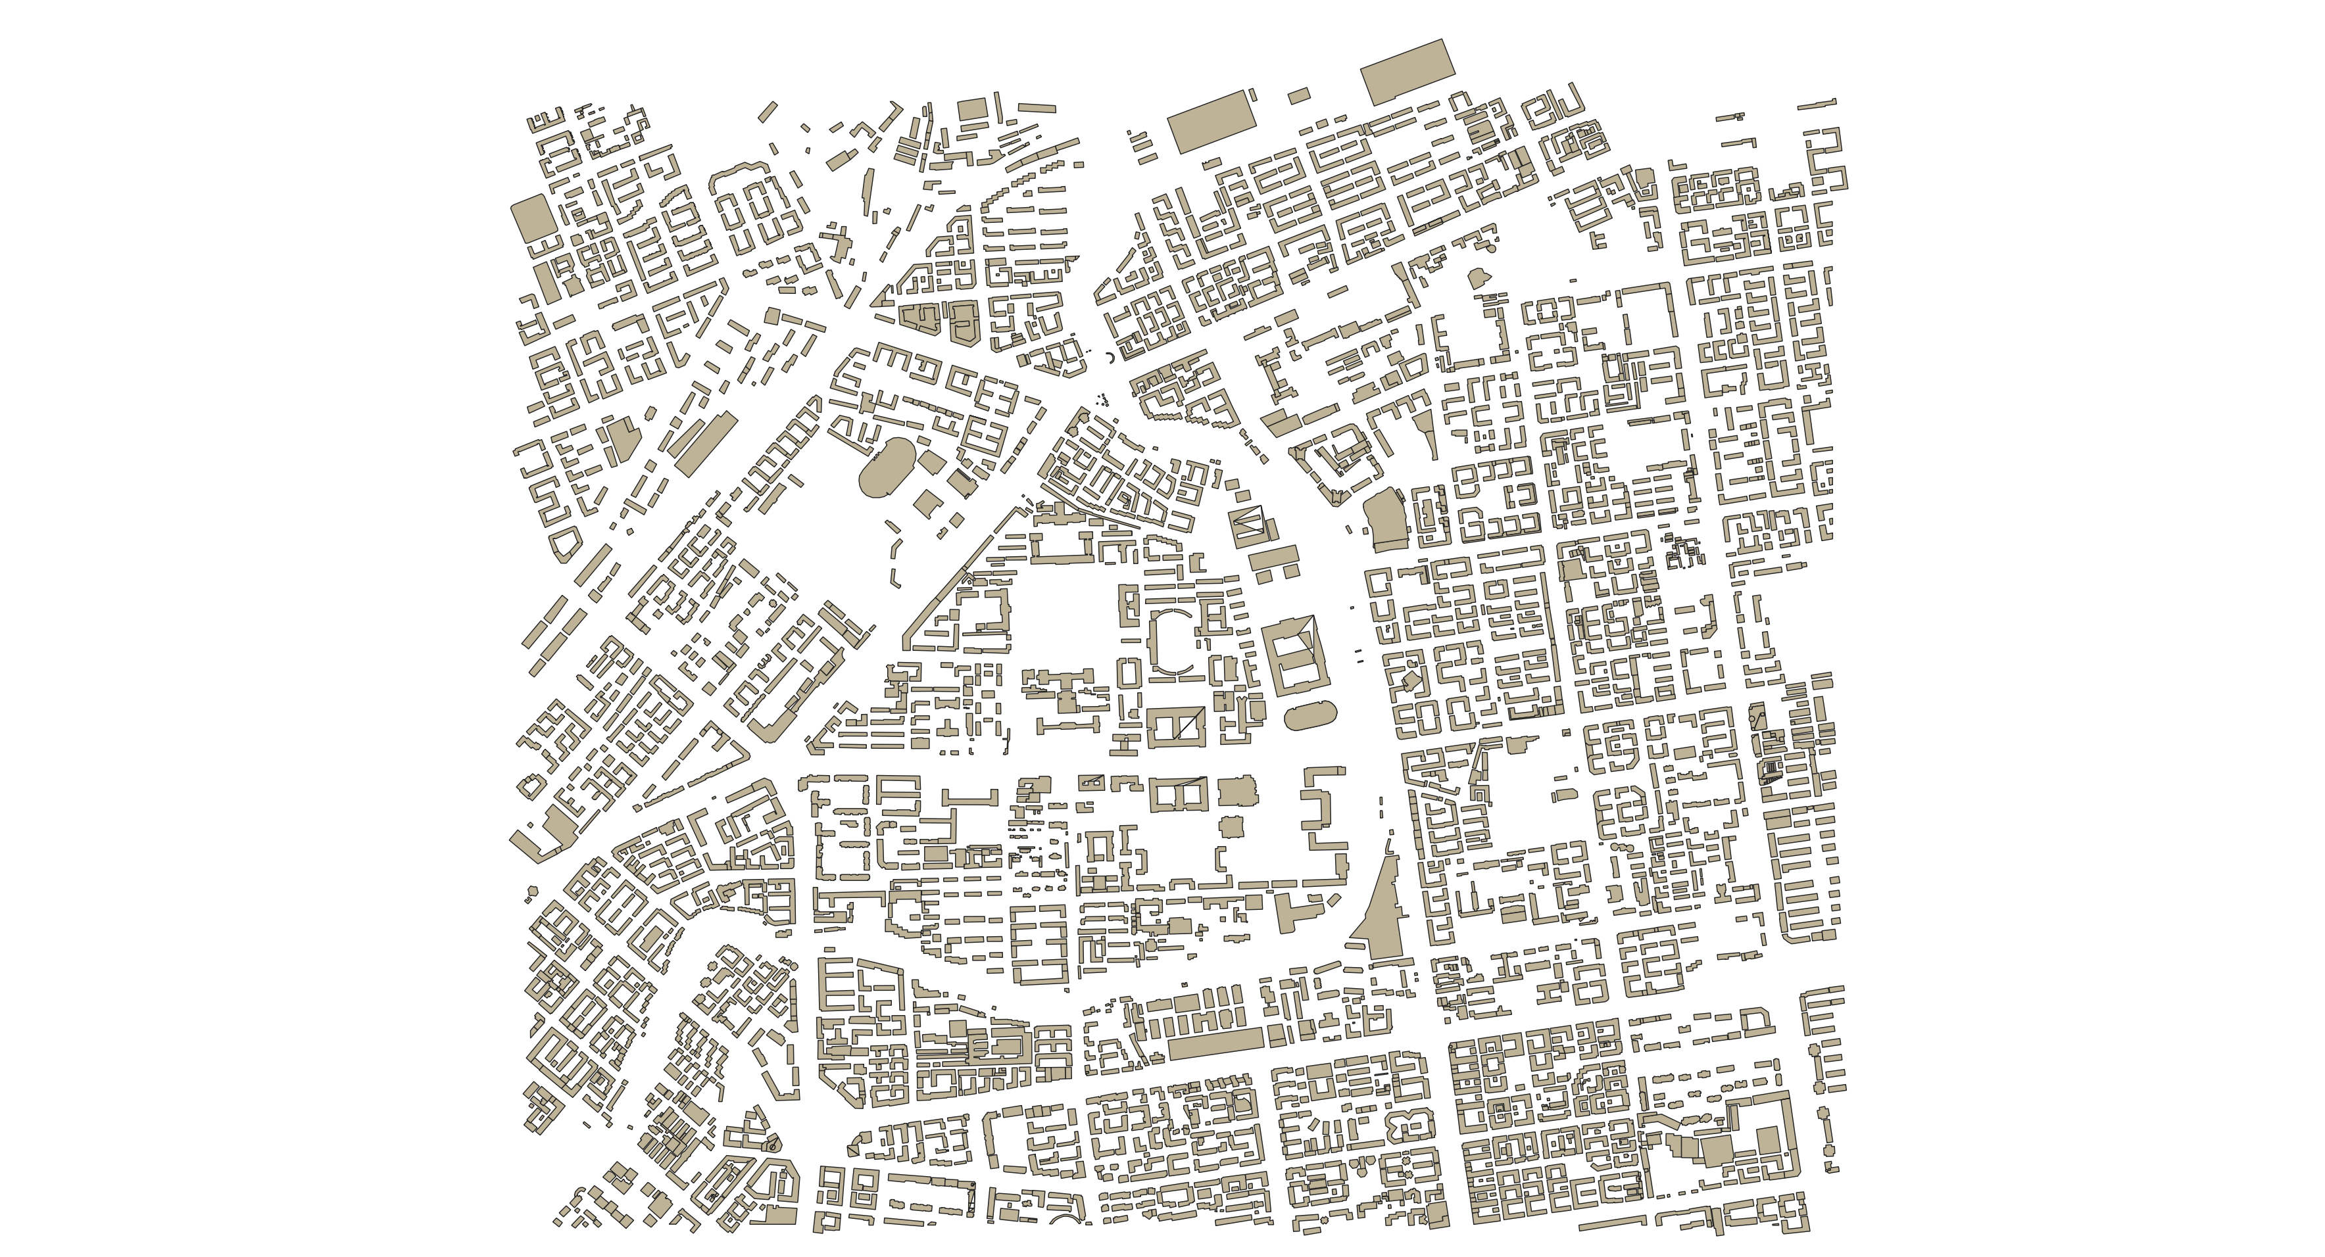
Data Generation for Pathsim
A ray tracing program (Wireless Insite) was used to generate the signal field from 13 towers (39 base stations) placed at random locations in the area.
Simulated 4km x 4km 3D urban area, taking into account of building heights
Our study focuses on the 2D matrix that is generated from the above program where each location contains a signal vector that includes Tadv, AoA, and RSRP values.

Slide 47
Simulation Path Generation
Many techniques were attempted and considered for Pathsim. These included:
Weight Buildings Method using Dijkstra
Shortest Path using Binary Matrices
The A* Method
Tests were conducted in MATLAB
Notes:
Realistic path simulation is also a major drawback in Vecsim that we aim to solve in Pathsim. The idea is we wanted to generate random paths to test our results, however we wanted these paths to represent actual human walking patterns, like walking on sidewalks instead of the middle of the road, while still trying to take the shortest distance between 2 points. Since we only maintain the building information with a set of 0s and the road information with a set of 1s, we tried some methods to generate realistic looking paths.

Slide 48
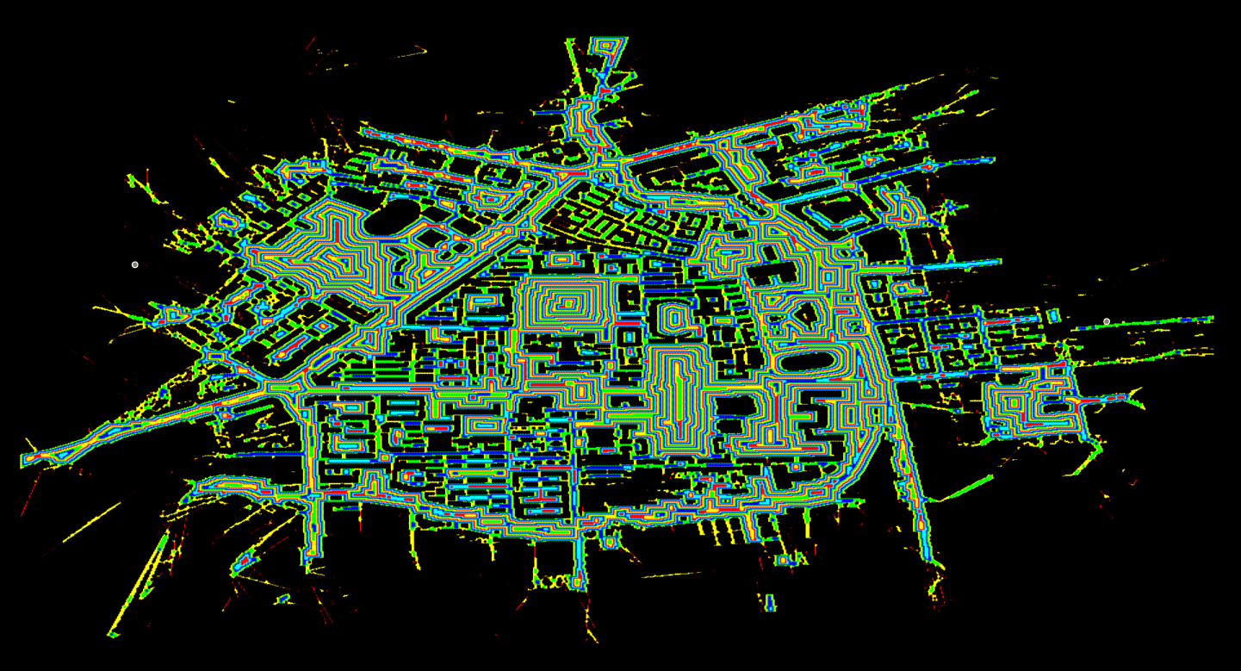
Weighted Buildings Method Generated realistic paths that hugged the buildings.
Connected graph
Less weights next to buildings (sidewalks)
Applied Dijkstra’s method
Complex map generation
Dijkstra compares too many nodes
Time consuming
Notes:
For the weighted buildings method, we basically assign a lower cost to road locations right next to buildings. This simulates a sidewalk, and running Dijkstra algorithm results in the person’s path hugging the street next to the building simulating a person walking on a sidewalk. This is also a challenging test case for Pathsim, since a lot of locations next to building walls, form discontinuity pairs.
Dijkstra's algorithm is an algorithm for finding the shortest paths between nodes in a graph, which may represent, for example, road networks. Dijkstra's original algorithm found the shortest path between two given nodes, but a more common variant fixes a single node as the "source" node and finds shortest paths from the source to all other nodes in the graph, producing a shortest-path tree.
We used lower weights next to buildings so that the Dijkstra’s algorithm would be able to find the shortest path based on the lowest cost. This is because what Dijkstra’s does is it is a best-first search algorithm, meaning it knows the target node and starting node (informed search), that initially sets the beginning node to 0 and the rest of the nodes to infinity. Then it compares the cost to get to each subsequent node and tries to reduce the total costs until finally it reaches the target node.

Slide 49
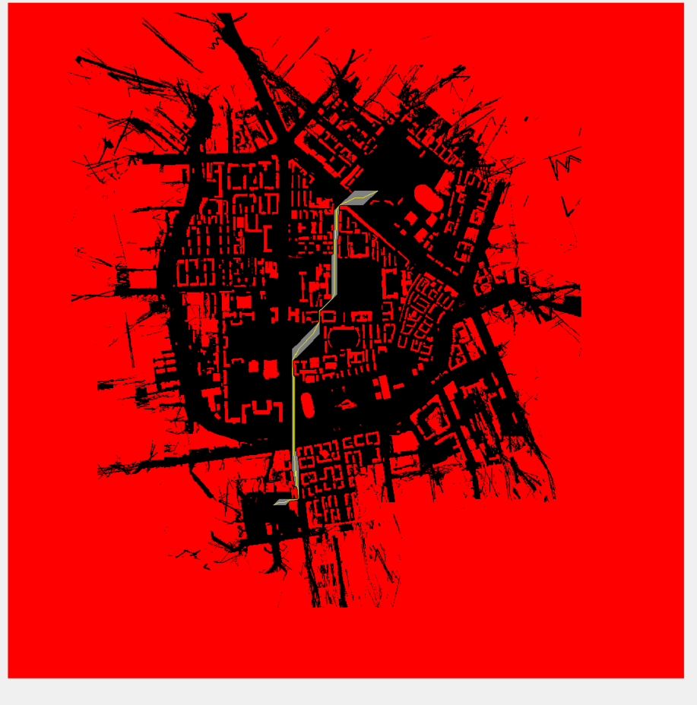
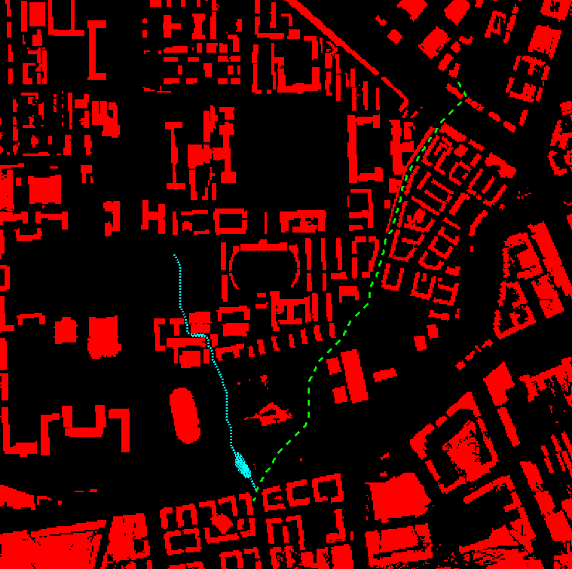
Shortest Path using Binary Matrices
Uses shortest path in MATLAB plus binary matrices to generate paths
Gray area = possible routes
Yellow line = shortest path
Uses the bwgeodesic function in MATLAB which computes every distance from 0 to 1 in a matrix
Unrealistic paths
High failure rate (infinite paths)
Notes:
D = bwdistgeodesic(BW,mask) computes the geodesic distance transform, given the binary image BW and the seed locations specified by mask. Regions where BW is true represent valid regions that can be traversed in the computation of the distance transform.
We then computed two of the geodesic matrices and take the sum of these matrices and find the shortest path by using the smallest sums along the paths.
Unrealistic – do not hug the buildings and only takes the absolute shortest paths
High failure, due to the bwgeodesic function not allowing the path to pass through or considering too many paths like shown in the picture where there may be more than 1 exact path that could not be thinned correctly in MATLAB

Slide 50
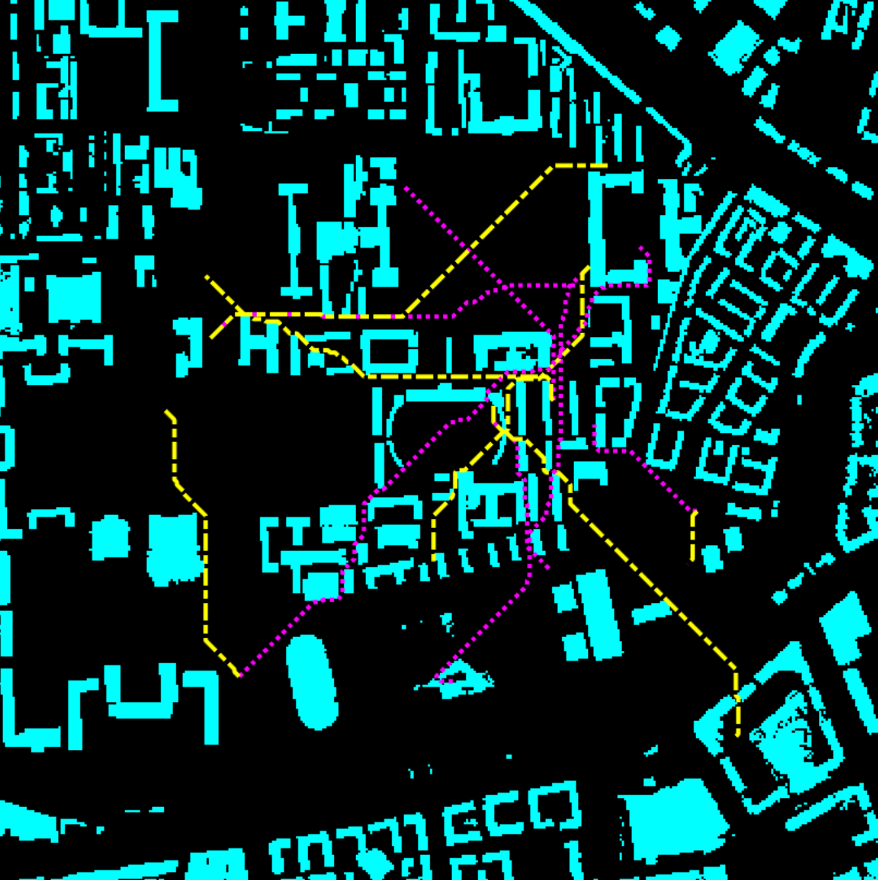
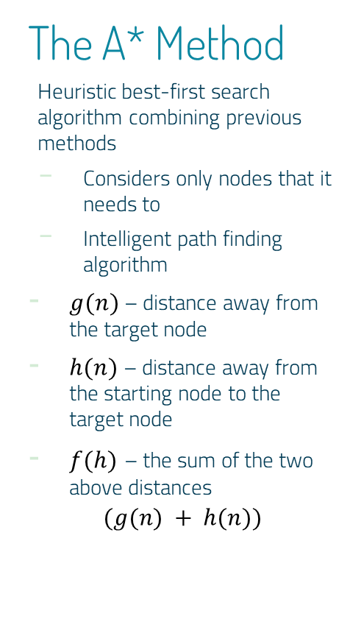
The A* Method
Heuristic best-first search algorithm combining previous methods
Considers only nodes that it needs to
Intelligent path finding algorithm
$g(n)$ – distance away from the target node
$h(n)$ – distance away from the starting node to the target node
$f(h)$ – the sum of the two above distances
$$(g(n) + h(n))$$
More front-end processing required
More complex since it stores all generated nodes in memory
Less failed paths
Notes:
A* is an informed search algorithm, or a best-first search, meaning that it is formulated in terms of weighted graphs: starting from a specific starting node of a graph, it aims to find a path to the given goal node having the smallest cost (least distance travelled, shortest time, etc.). It does this by maintaining a tree of paths originating at the start node and extending those paths one edge at a time until its termination criterion is satisfied.
First explain A* first and how it is better - A* is always better than Dijkstra as it performs informed rather than uninformed search: it expands more promising vertices than Dijkstra because A* considers additional information about the minimal distance to the target.
Front-end processing – needs to keep track of the functions and distance calculations and must do the distance calculations at every step

Slide 51

A* Method Demonstration
Notes:
You can see the path is trying to hug the walls of the building whenever possible all while trying to minimize the distance the path needs to take from the starting node (red circle) to the end node (green)

Slide 52
PATHSIM
Contact Tracing
Cellphone LTE Network
VECSIM Prior Work
PATHSIM
Distance Estimation
Path Generation
Tests
Evaluation
PATHSIM Conclusions

Slide 53
PATHSIM Tests
1. Paths with Common Source
2. Paths with Common Destination
3. Paths with Common
Midpoint
4. Proximity Paths

Slide 54
1. Paths with Common Source or 2. Common Destination
Two paths (A and B), with the same starting point, but different random ending points
Yielded same results for destination paths
Notes:
In either of the tests Pathsim was able to correctly to identify that the users were close at the start of the path and started to veer off in larger distances because it would have a few scores of 1 or 2, then the other points would be distributed in a scatter.
From our findings:
We noticed that for path pairs that share a common source, Pathsim was correctly able detect that the starting location pairs were in close proximity 97% of the time. After that the score would become much larger as the paths veered off.
For cases where the destination was the same Pathsim could correctly identify that the locations near the ends of the paths were close 100% of the time.

Slide 55
3. Paths with a Common Midpoint
Two paths (A and B), that meet somewhere in the middle but have random starting and ending points.
Was a combination of paths from first test and 3 extra random paths using midpoint
Notes:
Again, Pathsim was able to correctly to identify that the users were close at the middle of the path and the rest of the paths would veer off because Pathsim would compute that a few points were close together in one or two timestamps, but the other points would be of various distances.
Pathsim was able to detect that the paths met in the middle 98% of the time. We note that upon manual inspection, the cases that Pathsim failed to identify, had a very weak or discontinuous signal from either one or both MRO vectors. If possible add these numbers to the slides.

Slide 56
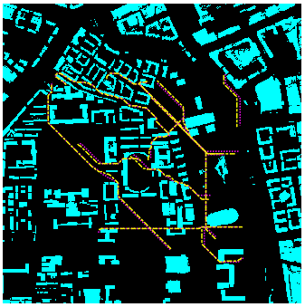
4. Proximity Paths
Used a series of random points in a radius near each other (5) for both starting and ending points to create 925 very similar paths
Notes:
Proximity paths was our main and final test that we used to compare Pathsim with Vecsim and figure out how much more Pathsim improved over Vecsim. This is because in this specific test, both Vecsim and Pathsim should show a very low score for all of the points being compared since they are nearly the same path.

Slide 57
PATHSIM
Contact Tracing
Cellphone LTE Network
VECSIM Prior Work
PATHSIM
Distance Estimation
Path Generation
Tests
Evaluation
PATHSIM Conclusions

Slide 58
PATHSIM IMPROVEMENT OVER VECSIM
109,827 pairs of points
Vecsim failed ~22% to produce a similarity score
Pathsim only 5%
Holds the same with or without DPD (since Vecsim does the validity check first)
Notes:
In the roughly 1000 paths that we generated, we generated over 100k unique pairs of locations that were compared.
Keep in mind for these tests, these paths were very close to each other. In an ideal world, we should have seen a similarity score of 1 or 2, but Vecsim was unable to produce a large fraction of these scores! This is because of the fact that the signals were connected to different base stations.
Vecsim 22% of close pairs locations, Pathsim 5%, same for both DPD and without DPD. This is because it checks validity check first and only does the DPD check if the score is > 4 (or 100 meters)

Slide 59
PATHSIM IMPROVEMENT OVER VECSIM
Cumulative Density Functions of similarity scores for the similar paths simulation tests
Higher accuracy with DPD
Simple mode performed better than averaged mode
Notes:
Path accuracy. In an ideal scenario, we should see a score of a<4 for almost all of the pair locations, since the locations were fairly close to each other.
This is a cumulative density function plot of the similarity scores for these relatively close pairs,
Left is without Discontinuity Pair Database check. Vecsim gets a score 80% of the time whereas Pathsim is around 84%.
And, things only get better when we incorporate the DPD check. Vecsim gets a higher accuracy score of 95% whereas Pathsim is 96% with simple mode.

Slide 60
PATHSIM IMPROVEMENT OVER VECSIM
 | PATHSIM | VECSIM | IMPROVEMENT
Invalid Pairs | 5% | 22% | 16%
Accuracy without DPD | 84% | 80% | 4%
Accuracy with DPD | 96% | 95% | 1%

Slide 61
PATHSIM
Contact Tracing
Cellphone LTE Network
VECSIM Prior Work
PATHSIM
Distance Estimation
Path Generation
Tests
Evaluation
PATHSIM Conclusions

Slide 62
5. CONCLUSIONS
Accuracy Improvement
Pathsim offered a modest improvement over Vecsim in terms of accuracy
Able to compare Location Pairs that are Connected to Different Base Stations
Pathsim is able to compute the distance estimate for over 4 times more pairs of points that Vecsim could not.
Big Future Opportunity
Pathsim demonstrates ability to use preprocessing to generate more accurate measurements while still preserving user privacy. This will get better with more technology advances.

Slide 63
Pathsim Limitations
Pathsim is still bound to outdoor methods, but can be complementary to other methods
Pathsim assumes all cellphones are oriented in the same direction
Also assumes all MRO data belongs to 1 carrier
Length of time to become fully adopted might be long due to multiple carriers needing to collaborate
Notes:
Modeling indoor is difficult, because of the indoor signal is scattered and permeates through material. Detailed indoor environment is difficult to gather.
Indoor environments, Pathsim is complementary to other methods . Always can use Bluetooth in parallel

Slide 64
Future Work
Innovative technology can help Pathsim
New faster coding languages
Artificial Intelligence
Hardware and software advances
Pathsim’s algorithm can be further developed with more standardized MRO data to estimate how long users have been in contact

Slide 65
PATHSIM SWOT ANALYSIS
STRENGTHS
Highly efficient contact tracing method that can determine user proximity with 96% accuracy
WEAKNESSES
Performance depends on hardware and software and can only work outdoors
S
W
Algorithm can be improved with innovative technology and can complement other contact tracing methods
OPPORTUNITIES
Length of time to become fully adopted might be long due to multiple carriers
THREATS
O
T

Slide 66
Contributors
Avishek Mukherjee
Ph. D. ASSISTANT PROFESSOR
Computer Science and Information Systems
Saginaw Valley State University
Michael Mark
BSE - Industrial & Operations Engineering, University of Michigan, 2010
Wireless Network Research Group:
Anthony Galea
Beata A. Hejno
Morgan B. Simmons
Additional thanks to:
Poonam Dharam, Ph. D. Associate Professor
Khandaker Abir Rahman, Ph.D. Associate Professor

Slide 67
THANKS!
Any questions?
You can find me at:
mmark@svsu.edu

